Slide 1
Stock trend prediction based on social media articles
Why this topic?
We can observe the current stock trends of several portfolios, which are significantly different in terms of how much they are actually worth due to social media buzz. We are attempting to determine the relationship between tweets and stock price behavior.
Dataset?
We used TWINT to scrape the needed tweets from Twitter (~85,000 tweets).
The search terms used to gather the tweets (“Tesla”, “Elon Musk”, “@Tesla”, “@elonmusk”, “$TSLA” and “#Tesla”). Specified time frame.
The stock data is obtained from yahoo finance with the same time frame.
Manually labeled 5000 tweets for training and testing.
Abhinav Yalamaddi And Satwik Arvapalli
https://github.com/twintproject/twint

Slide 2
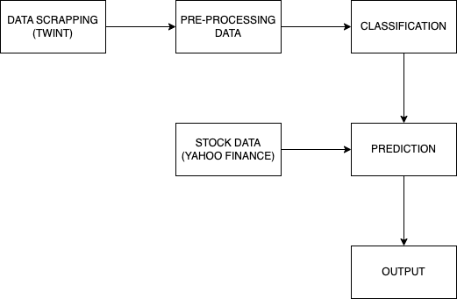
Model Overview
Preprocessing - Generated Wordlist
Classification - Used the word list generated as input of the model and classified the sentiment of the tweets by using Naive Bayes and Logistic Regression.
Prediction - Merged the stock data and tweet polarities estimated to make the final prediction and correlation.
Abhinav Yalamaddi And Satwik Arvapalli

Slide 3
Classification of Tweets
Methods Used For classifying the positive and negative tweets.
Naive Bayes (89.8% accuracy)
Logistic Regression (76.3% accuracy)
Quantified the tweets as polarity for each day w.r.t Likes, retweets.
Prediction of stock Trend
We took the average sentiment across all the tweets for each day
Next steps - plot the polarity against the change in the stock price.
We also need to calculate the correlation coefficient to get a more objective measure of how the two variables correlate
Observation
Our analysis does not evaluate many parameters since our dataset does not represent actual public sentiment; it just considers Twitter users. If the real opinion is analyzed, a greater correlation can be obtained.
Challenges
We are only able to predict the raise and fall of the stock, but not the actual percentage change.
Abhinav Yalamaddi And Satwik Arvapalli

